Slide 1

Transformations, Coordinate systems and Camera
Lecturer : Tanaboon Tongbuasirilai
Course : ICCS404
Week 5 : Transformations

Slide 2
Topics
3D Coordinates
Vector, matrix and operations
Basic transformations
GLM : OpenGL Mathematics library
Moving between coordinates and projections in OpenGL
Camera
Most of the content in this lecture is from https://learnopengl.com/Getting-started/OpenGL,
https://math.hws.edu/graphicsbook/c3/s2.html
and https://pbr-book.org/3ed-2018/Geometry_and_Transformations.

Slide 3

3D Coordinates
A coordinate system is a way of assigning numbers to points.
In two dimensions, you need a pair of numbers to specify a point. The coordinates are often referred to as x and y.
The assignment of pairs of numbers to points is itself arbitrary to a large extent.
Points and objects are real things, but coordinates are just numbers that we assign to them so that we can refer to them easily and work with them mathematically.
In three dimensions, you need three numbers to specify a point.
The third coordinate is often called z. The z-axis is perpendicular to both the x-axis and the y-axis.
Notes:
Points and objects = real things = something concrete
Coordinates = numbers = locations → think about how we can locate a location on Google map.

Slide 4
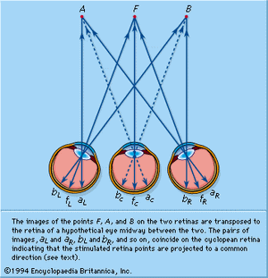
What humans see …
The image of the external world on the retina is essentially flat or two-dimensional, and yet it is possible to appreciate its three-dimensional character with remarkable precision.
Viewing from different angles gives some sense of depth to the human brain.
The perception of depth in a two-dimensional pattern thus depends greatly on experience—the knowledge of the true shape of things when viewed in a certain way.
https://www.britannica.com/science/human-eye/Electrophysiology-of-the-visual-centres
Notes:
Talking about light transport problem ?
We see photons bouncing through eyes. → 2D image → 3D interpretation from depth cue.

Slide 5
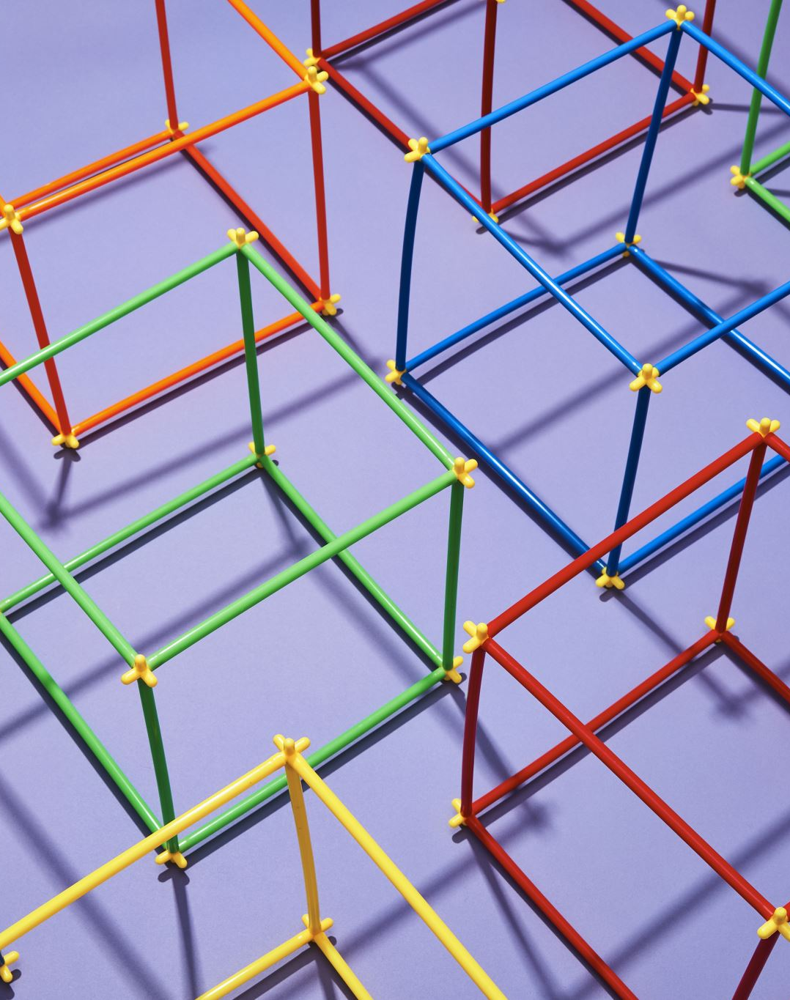
From 3D objects to 2D image.
Many transformations have to be done in a series of steps.
We transform an object's vertices to several coordinate systems before finally transforming them to normalized device coordinates (NDC).
The advantage of transforming them to several intermediate coordinate systems is that some operations/calculations are easier in certain coordinate systems.
Transformations of points (vertices) require vector-matrix operations to maintain alignments of the objects from real-world to NDC.
Notes:
NDC = 2D
We need a method how human eyes see such 2D image ! (Process from 3D to 2D

Slide 6
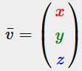
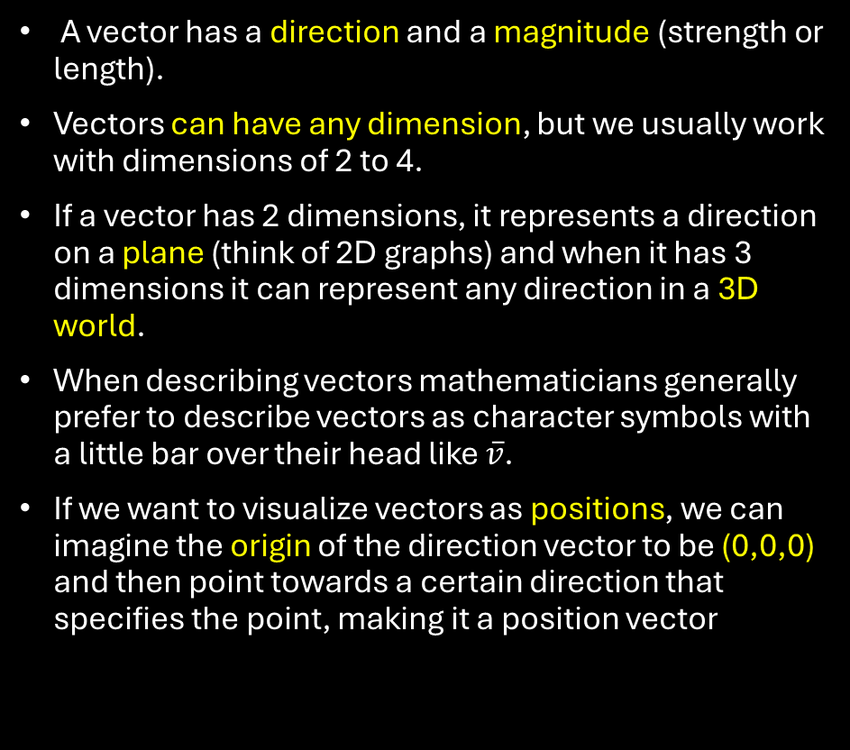
Vectors
A vector has a direction and a magnitude (strength or length).
Vectors can have any dimension, but we usually work with dimensions of 2 to 4.
If a vector has 2 dimensions, it represents a direction on a plane (think of 2D graphs) and when it has 3 dimensions it can represent any direction in a 3D world.
When describing vectors mathematicians generally prefer to describe vectors as character symbols with a little bar over their head like $\overline{v}$.
If we want to visualize vectors as positions, we can imagine the origin of the direction vector to be (0,0,0) and then point towards a certain direction that specifies the point, making it a position vector
Notes:
Direction = orientation
Magnitude = quantity

Slide 7
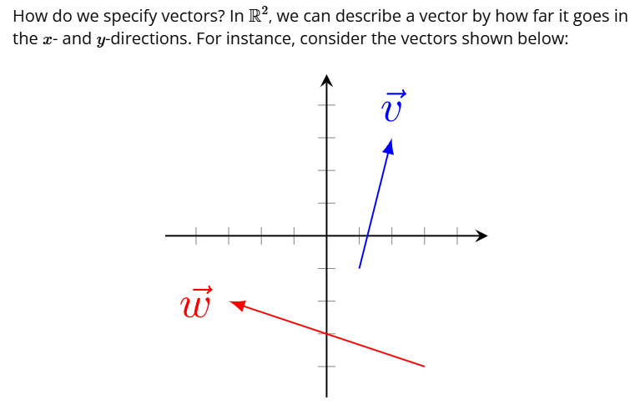
Specifying vectors
https://people.math.harvard.edu/~jjchen/math21a/handouts/vectors.html

Slide 8
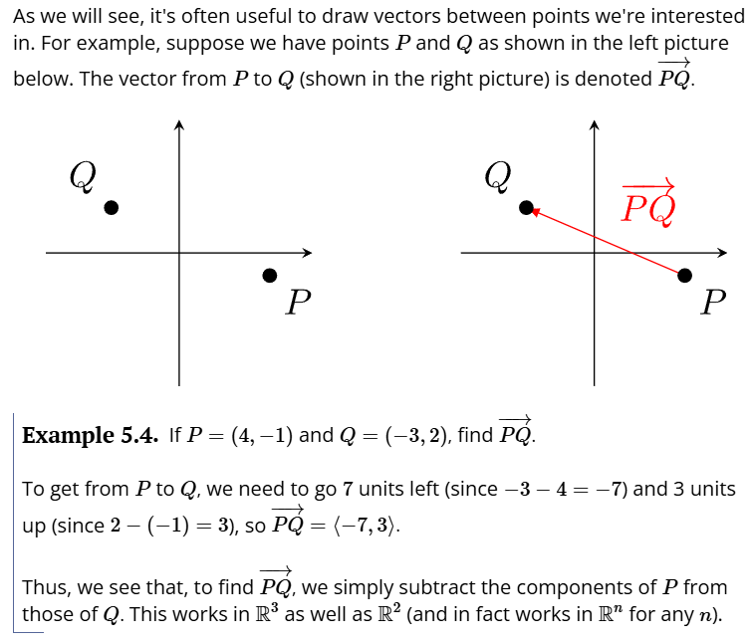
Vectors between points

Slide 9
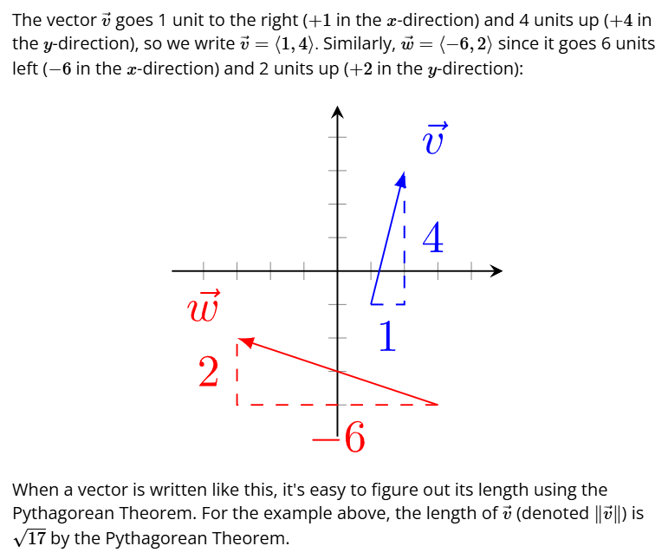
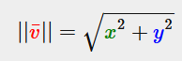
Length of a vector

Slide 10
Vector operations
Vector-scalar multiplication, division
Vector-vector addition, subtraction
Vector-vector multiplication
Dot product
Cross product

Slide 11
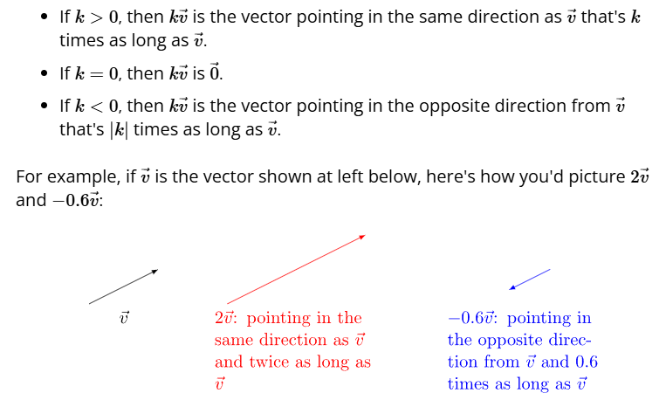
Vector-scalar multiplication, division
Negation
If 0 < |k| < 1, then it is a division operation.
Notes:
Having a scalar value multiplied → we can have
Increased length
Decreased length (or division)
Reverse
Orientation does not change ! Except the negation

Slide 12
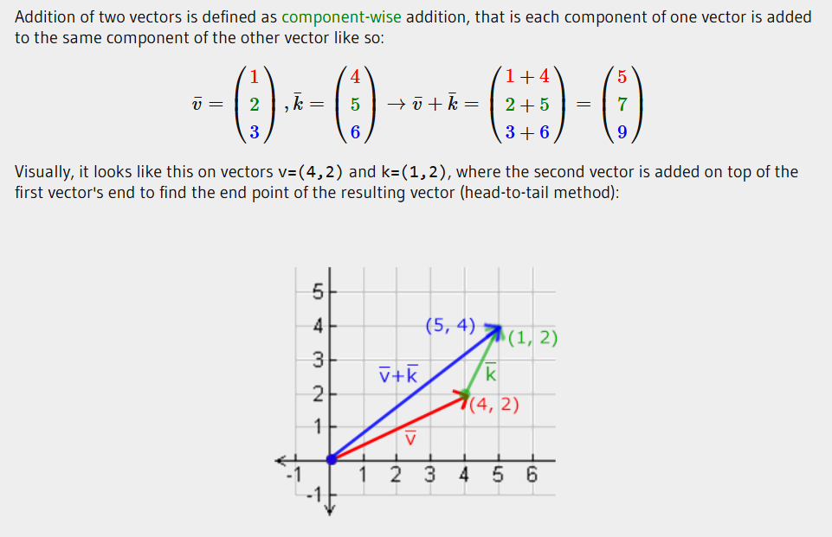
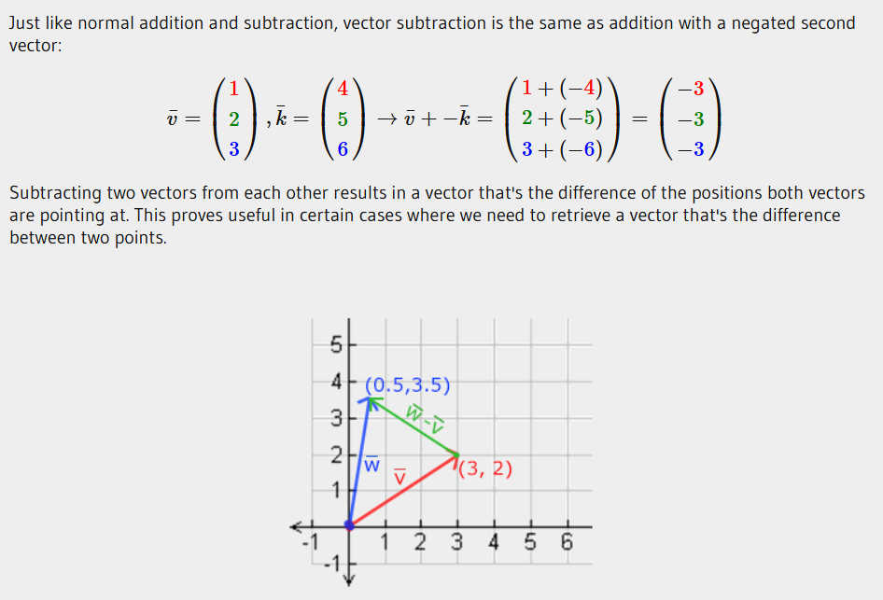
Vector-vector addition, subtraction
Notes:
A new vector with new length, new orientation.

Slide 13
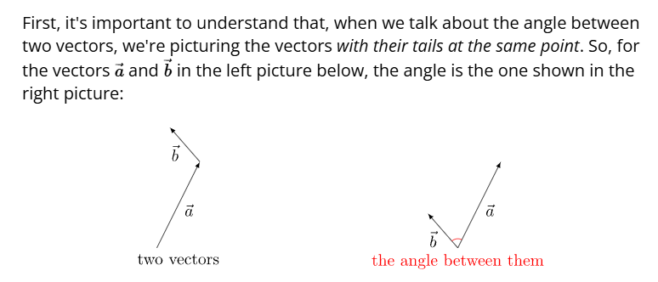
Dot product
The dot product is an operation on vectors that enables us to easily find the angle between two vectors.

Slide 14
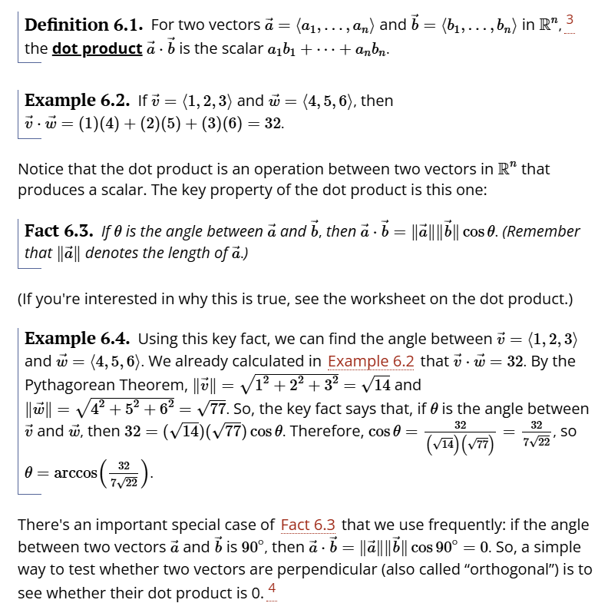
Definition
Notes:
2 formulars to calculate the dot product.
Linear combinations of the coefficients.
Projection between 2 vectors

Slide 15
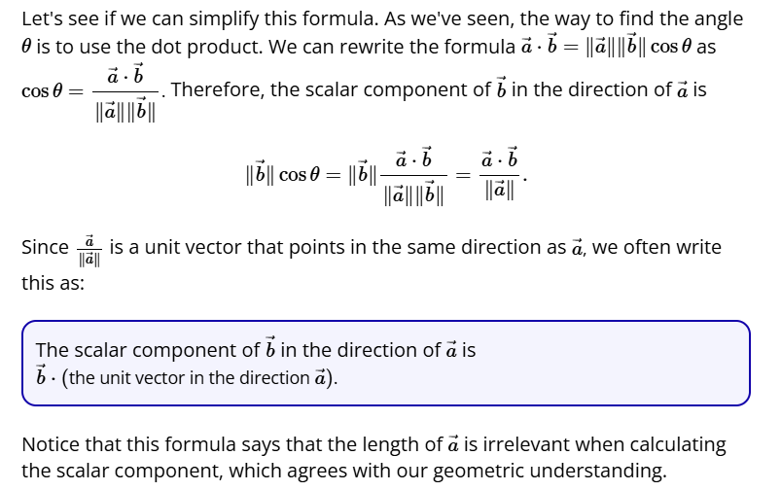
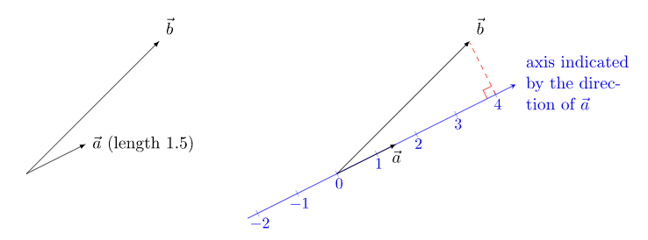
Scalar component / Projection
Notes:
If a and b are unit vectors → a.b = cos(theta)

Slide 16
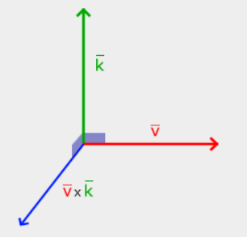
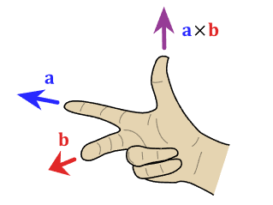
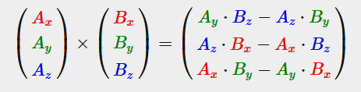
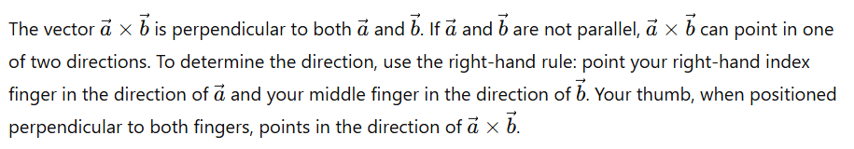
Cross product
The cross product is only defined in 3D space and takes two non-parallel vectors as input and produces a third vector that is orthogonal to both the input vectors.
Notes:
While dot product checks orthogonality, cross product forms an orthogonal vector.
2 vectors do not need to be orthogonal to each other.

Slide 17
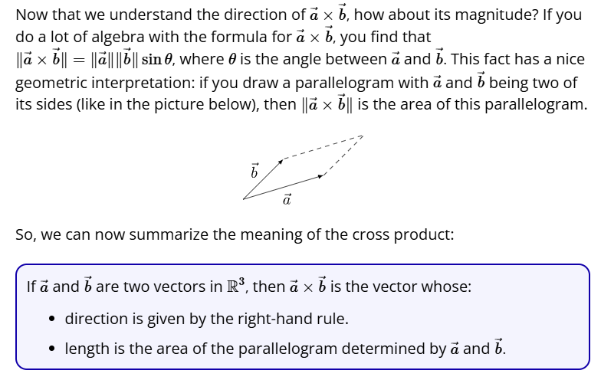
Length of cross product
Notes:
Area of parallelogram = base x height
Relationship :
New orthogonal vector has length = area form by the 2 vectors.

Slide 18
Matrix operations
Matrix-scalar multiplication, division
Matrix-matrix addition, subtraction
Matrix-matrix multiplication
Matrix-vector multiplication
Transpose of a matrix
Inverse of a matrix
https://www.geeksforgeeks.org/matrix-operations/

Slide 19
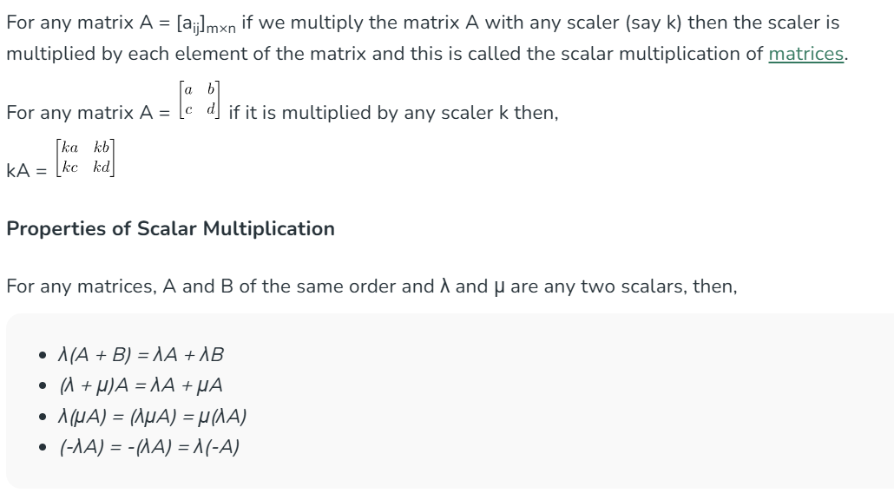
Matrix-scalar multiplication, division

Slide 20
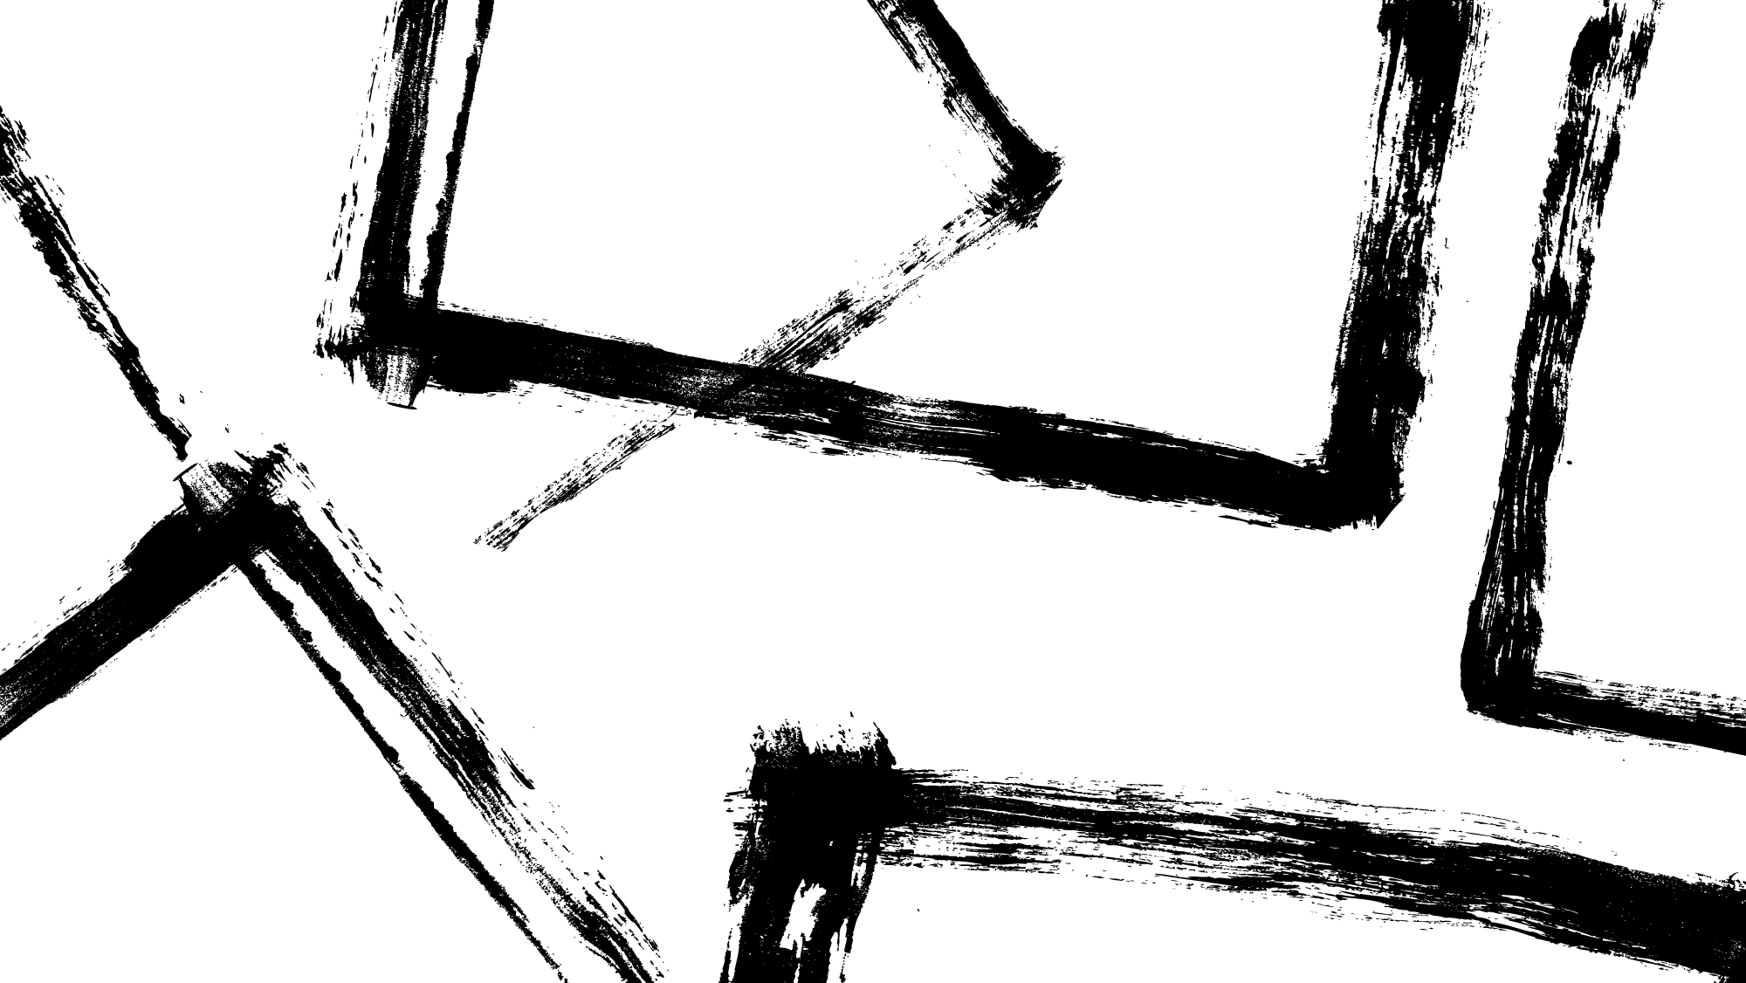
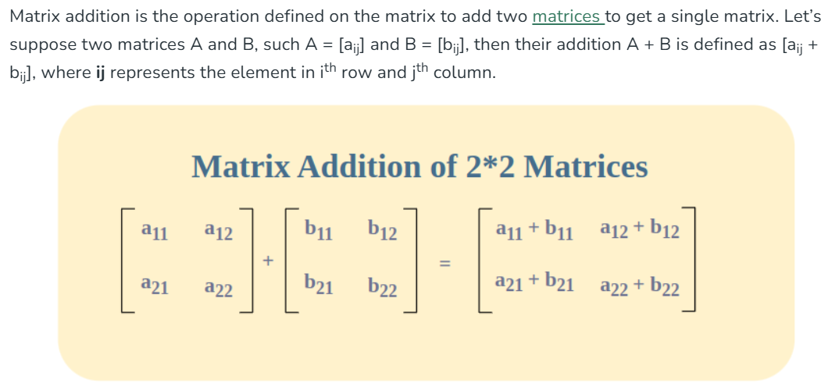
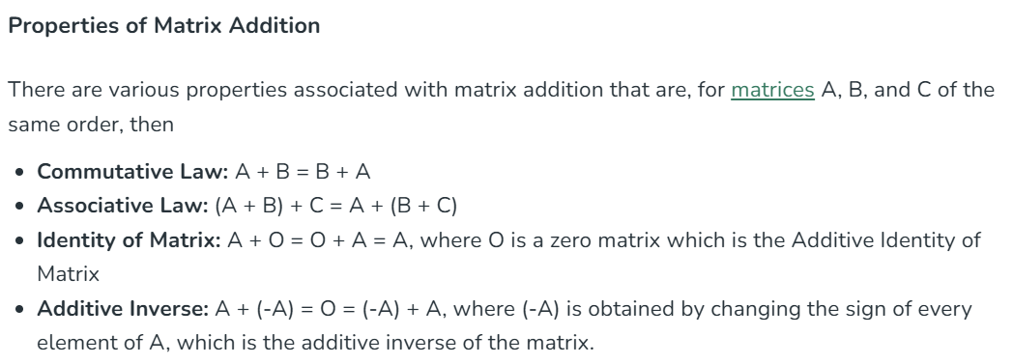
Matrix-matrix addition, subtraction

Slide 21
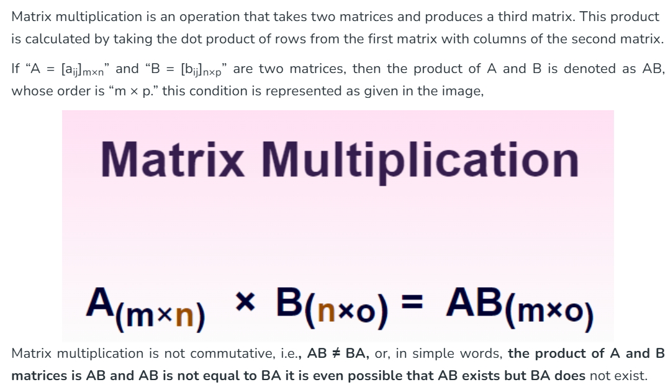
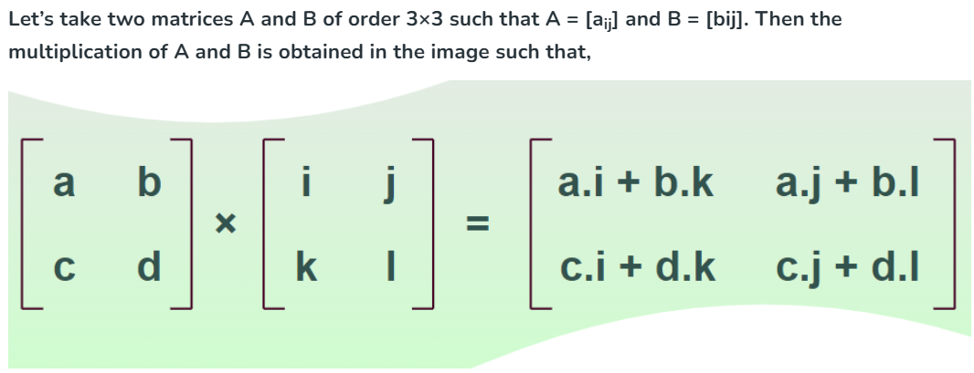
Matrix-matrix multiplication

Slide 22
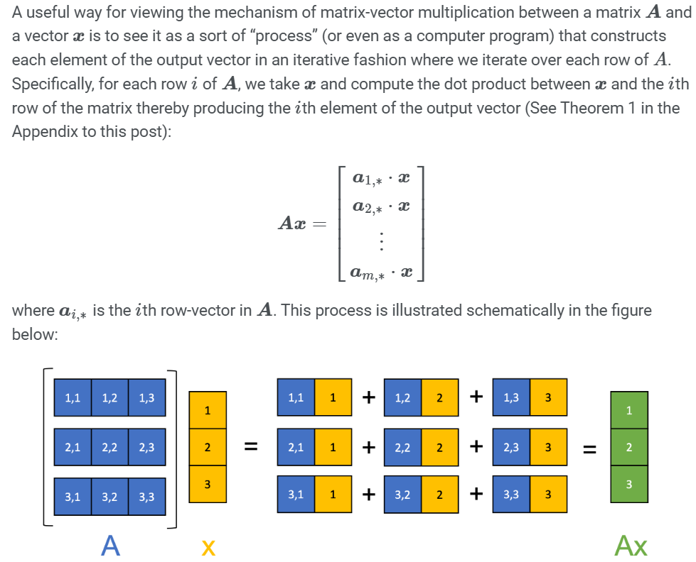
Matrix-vector multiplication
https://mbernste.github.io/posts/matrix_vector_mult
Notes:
Typical formular.

Slide 23
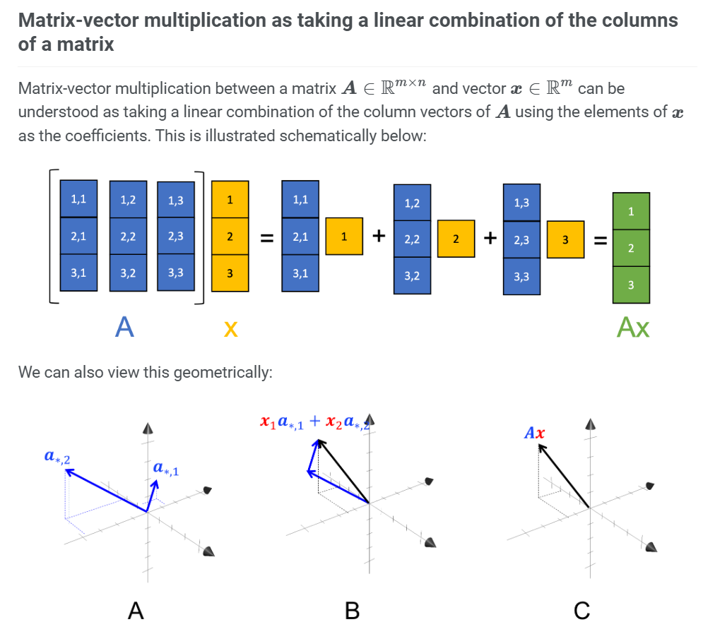
A linear combination of the columns of a matrix
Notes:
Another interpretation.
Matrix columns → scaled by a vector

Slide 24
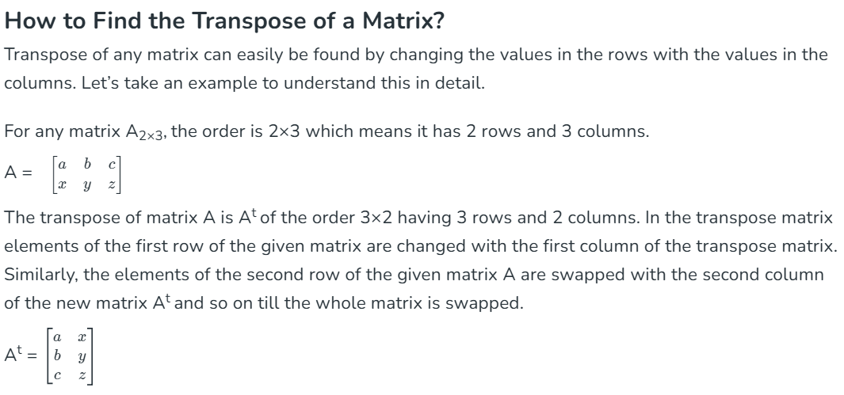
Transpose of a matrix

Slide 25
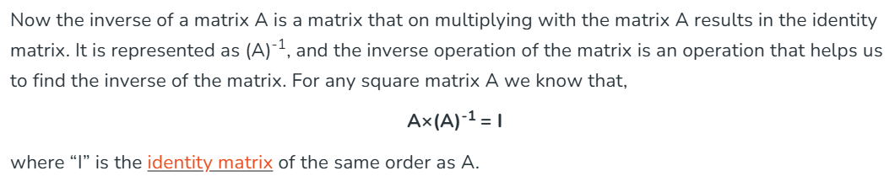
Inverse of a matrix
Notes:
One property -> A x inv(A) = identity matrix

Slide 26
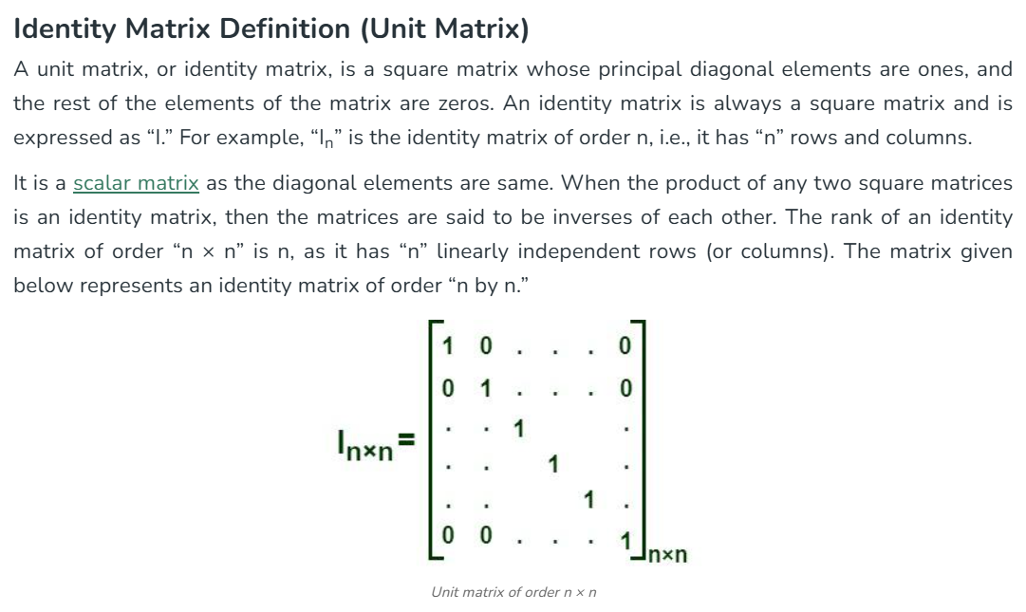
Identity matrix

Slide 27

3D Transformations in OpenGL
Translation
Scaling
Rotation

Slide 28
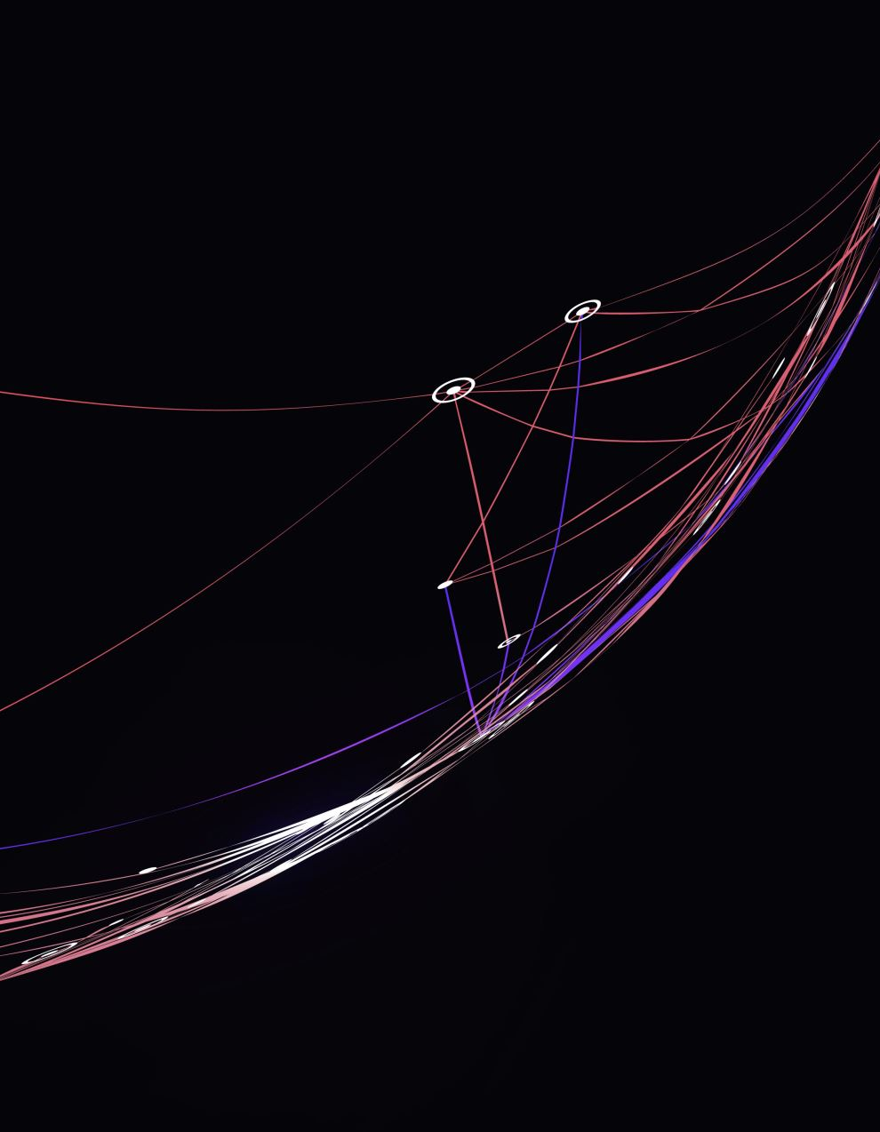
Affine transformation
An affine transformation is a type of linear mapping method that preserves points, straight lines, and planes.
In the context of computer graphics and OpenGL, affine transformations are widely used because they provide a way to perform geometric transformations such as translation, scaling, rotation, and shearing.
These transformations are essential for manipulating objects within a scene.

Slide 29
Key Properties of Affine Transformations
Linearity - Affine transformations preserve collinearity, meaning that points that lie on a straight line before the transformation will still lie on a straight line after the transformation.
Parallelism - Parallel lines remain parallel after an affine transformation.
Preservation of Ratios - Ratios of distances along parallel lines are preserved.

Slide 30
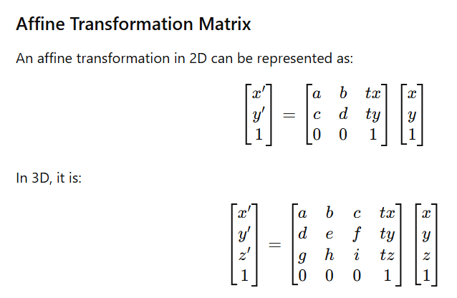
Example

Slide 31

Why Affine Transformations are Useful in Computer Graphics and OpenGL ?
Efficiency - Affine transformations can be represented and computed efficiently using matrix multiplication, which is supported natively by GPU hardware.
Combination - Multiple affine transformations can be concatenated into a single transformation matrix, allowing complex transformations to be performed with a single matrix multiplication.
Flexibility - Affine transformations encompass a wide range of geometric transformations that are essential for modeling and manipulating objects in a scene.
Preservation of Geometric Properties - Since affine transformations preserve lines and parallelism, they maintain the structural integrity of the objects being transformed.
Compatibility with Homogeneous Coordinates - Using homogeneous coordinates allows for the representation of translation as a matrix multiplication, integrating translation with other linear transformations (scaling, rotation, and shearing).

Slide 32
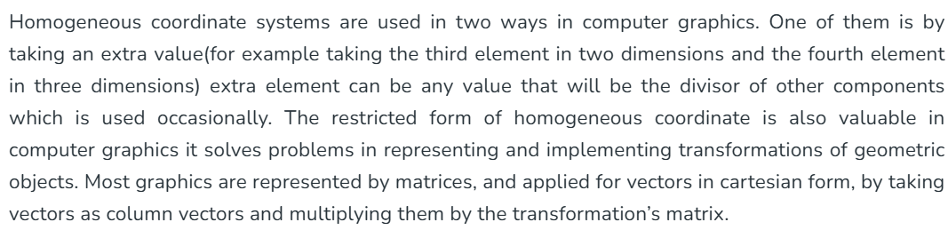
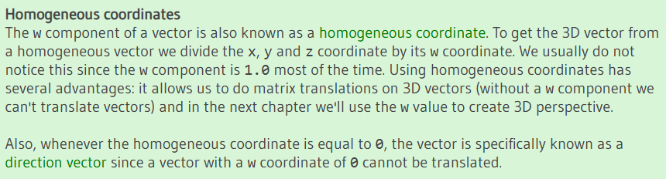
Homogeneous coordinates
Notes:
Homogeneous coordinate systems → common use in CG.
Adding an extra dimension to support transformation

Slide 33
Homogeneous coordinates
Homogeneous Coordinates in 2D
In 2D Cartesian coordinates, a point (x,y) is represented with two coordinates. In homogeneous coordinates, the point is represented using three coordinates (xh, yh, w), where w is a scaling factor.
Homogeneous Coordinates in 3D
Similarly, a 3D Cartesian point (x,y,z) can be represented in homogeneous coordinates by adding a fourth component.

Slide 34
Visual Explanation – Homogenous coordinates
https://www.youtube.com/watch?v=o-xwmTODTUI

Slide 35
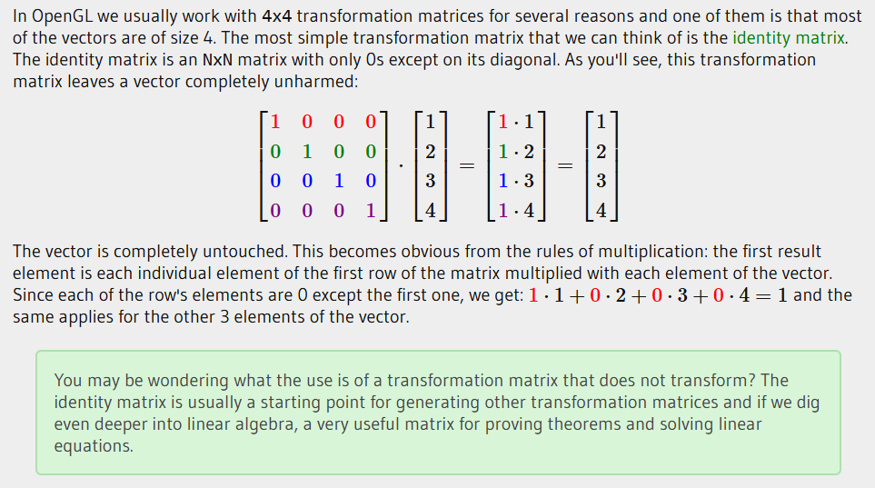
Identity transform
Notes:
Identity transform = do nothing = keep it original
Benefit ?

Slide 36
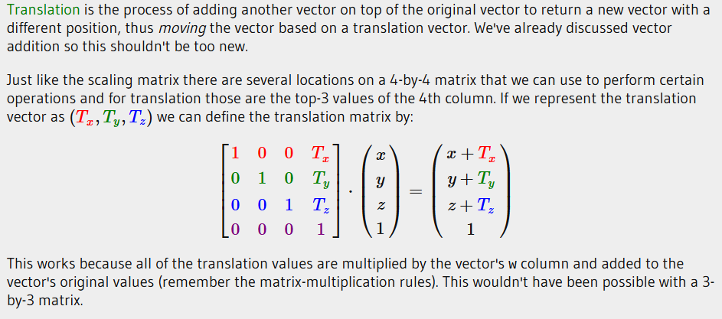
Translation

Slide 37
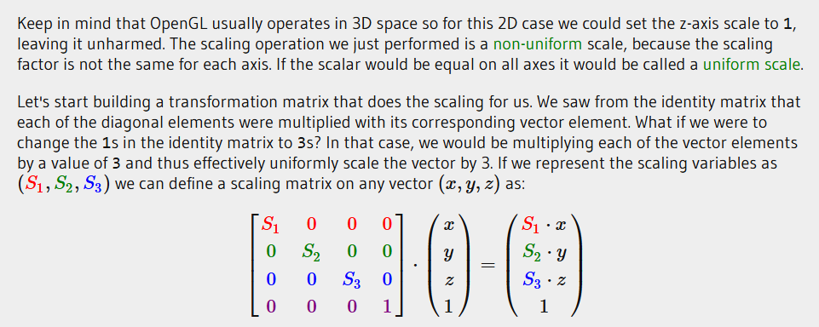
Scaling

Slide 38
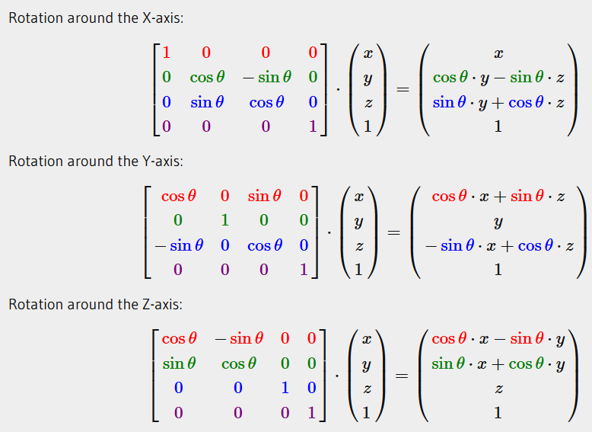
Rotation

Slide 39
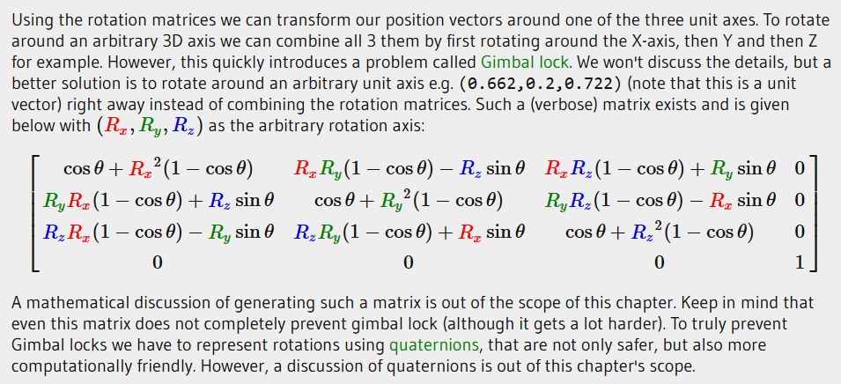
An all-axis rotation matrix
Visual explanation - https://www.youtube.com/watch?v=8GrdqAizcfU

Slide 40
Multiple transformations
In OpenGL, the order of transformations is critical because matrix multiplication is not commutative; changing the order of multiplication changes the result.
When applying a series of transformations to an object, the order in which you apply them will determine the final position, orientation, and scale of the object.
The typical order of transformations
Scaling -> Rotation -> Translation.
The right most matrix, for multiplication, ( the closest to the object ) is applied first.

Slide 41
Essence of linear algebra
Watch chapter 1 – 11.
https://www.youtube.com/playlist?list=PLZHQObOWTQDPD3MizzM2xVFitgF8hE_ab

Slide 42


OpenGL Mathematics
GLM stands for OpenGL Mathematics and is a header-only library, which means that we only have to include the proper header files and we're done; no linking and compiling necessary.
GLM can be downloaded from their website.
Installation is easy. Copy the root directory of the header files into your includes folder and let's get rolling.
Most of the functionality can be found in these header files.

Slide 43
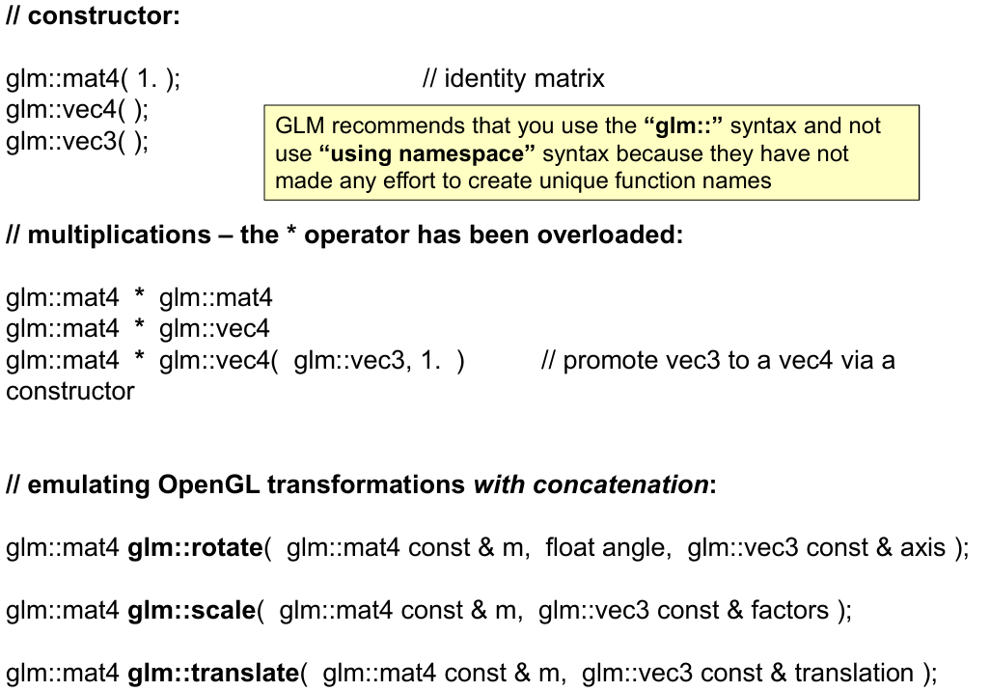
Basic GLM variables and operations
https://web.engr.oregonstate.edu/~mjb/cs491/Handouts/GLM.1pp.pdf

Slide 44
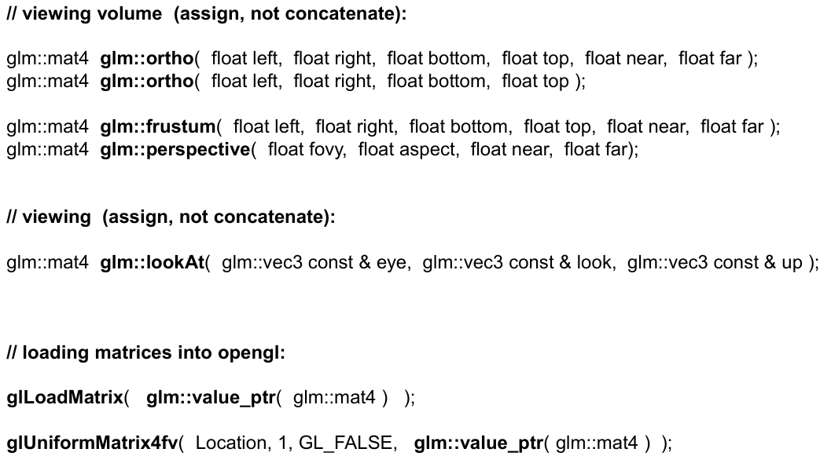
GLM functions

Slide 45
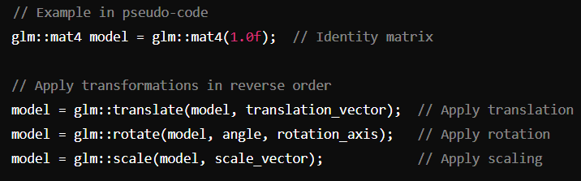
Examples : GLM and Affine transformations
Using stack to get a correct order.
Example
Notes:
Explain stacking of transformation matrices

Slide 46
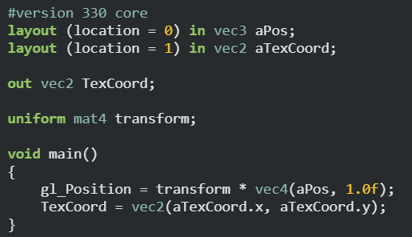
How do we get the transformation matrix to the shaders ?
Get the variable from the shader.
Bind the variable using GLM function and variable.
Notes:
Best practice for applying transformations in shaders.
We want to pass transformation to a shader.
Better to use ‘uniform’ → why ?
Note that passing a transformation matrix uses glm::value_ptr()

Slide 47
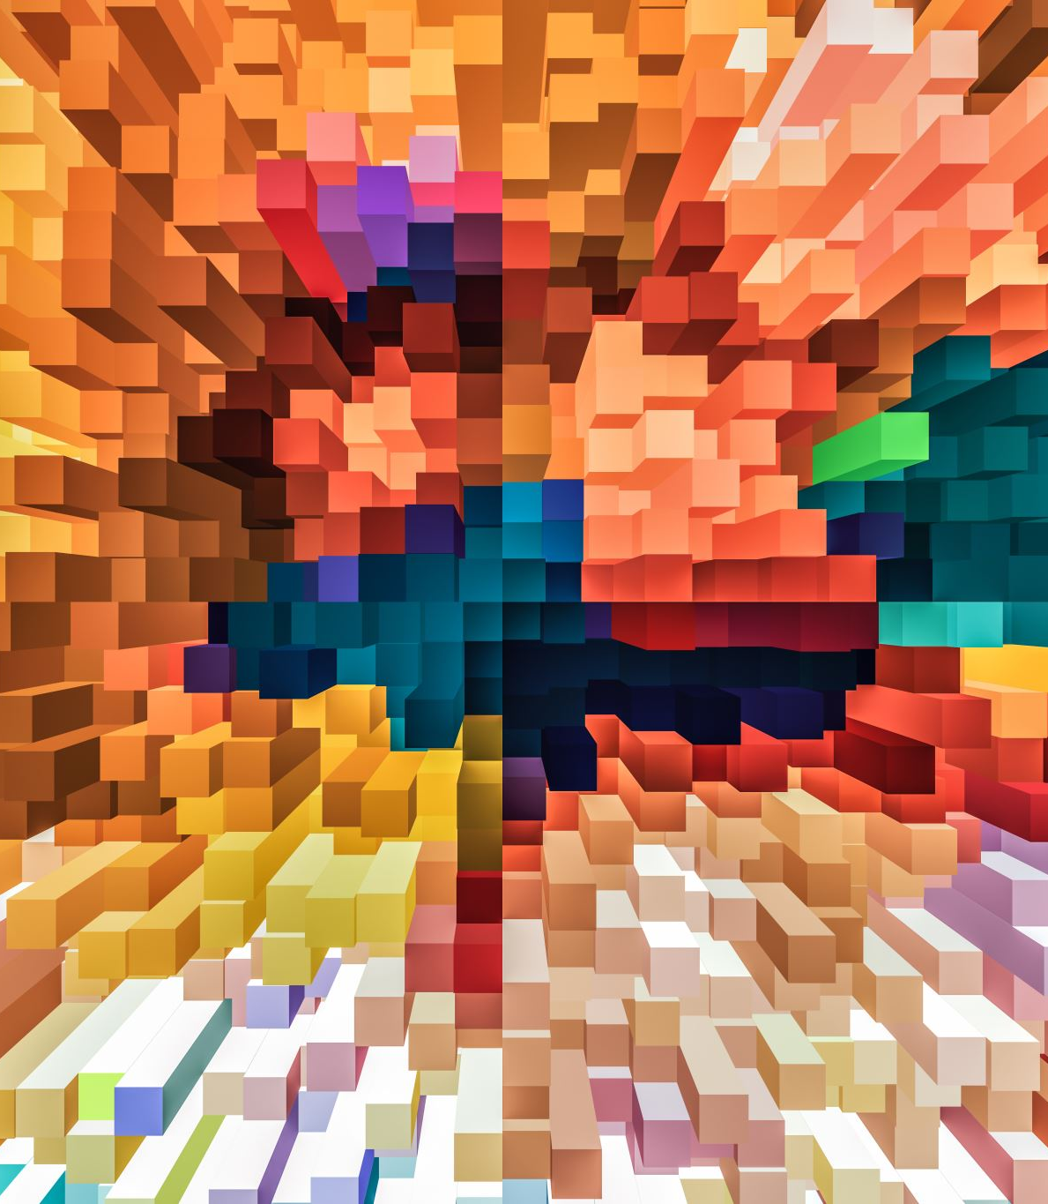
What’s next for the transformations in OpenGL?

Slide 48
So far…
Vector operations
Matrix operations
Affine transformations
GLM

Slide 49
5 coordinate systems when going from 3D points to an image
Local space (or Object space)
World space
View space (or Eye space)
Clip space
Screen space
Notes:
Applying tools to this pipeline.

Slide 50
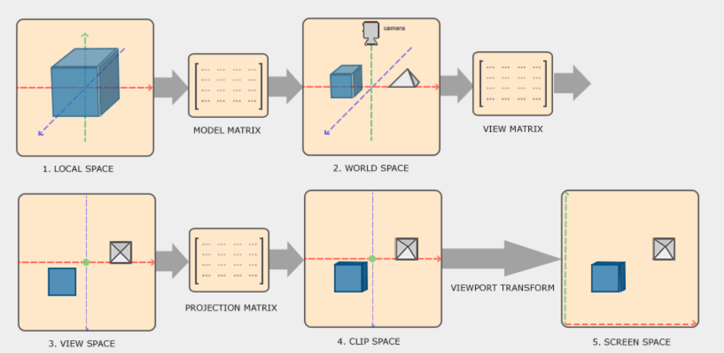
The big picture
Notes:
Local coordinates are the coordinates of your object relative to its local origin; they're the coordinates your object begins in.
The next step is to transform the local coordinates to world-space coordinates which are coordinates in respect of a larger world. These coordinates are relative to some global origin of the world, together with many other objects also placed relative to this world's origin.
Next we transform the world coordinates to view-space coordinates in such a way that each coordinate is as seen from the camera or viewer's point of view.
After the coordinates are in view space we want to project them to clip coordinates. Clip coordinates are processed to the -1.0 and 1.0 range and determine which vertices will end up on the screen. Projection to clip-space coordinates can add perspective if using perspective projection.
And lastly we transform the clip coordinates to screen coordinates in a process we call viewport transform that transforms the coordinates from -1.0 and 1.0 to the coordinate range defined by glViewport. The resulting coordinates are then sent to the rasterizer to turn them into fragments.

Slide 51
Local space
Local space is the coordinate space that is local to your object, i.e. where your object begins in.
In OpenGL, "local space" (also known as "object space" or "model space") refers to the coordinate system that is local to an object.
In this coordinate system, the object is defined relative to its own origin (0, 0, 0), which is typically located at the geometric center or another significant point of the object.
Transformations from Local Space to World Space
To place an object in the scene, its vertices need to be transformed from local space to world space. This is achieved through Model matrix.
The model matrix transforms coordinates from local space to world space. It includes translations, rotations, and scalings that position and orient the object within the global scene.
World Coordinates = Model Matrix × Local Coordinates

Slide 52
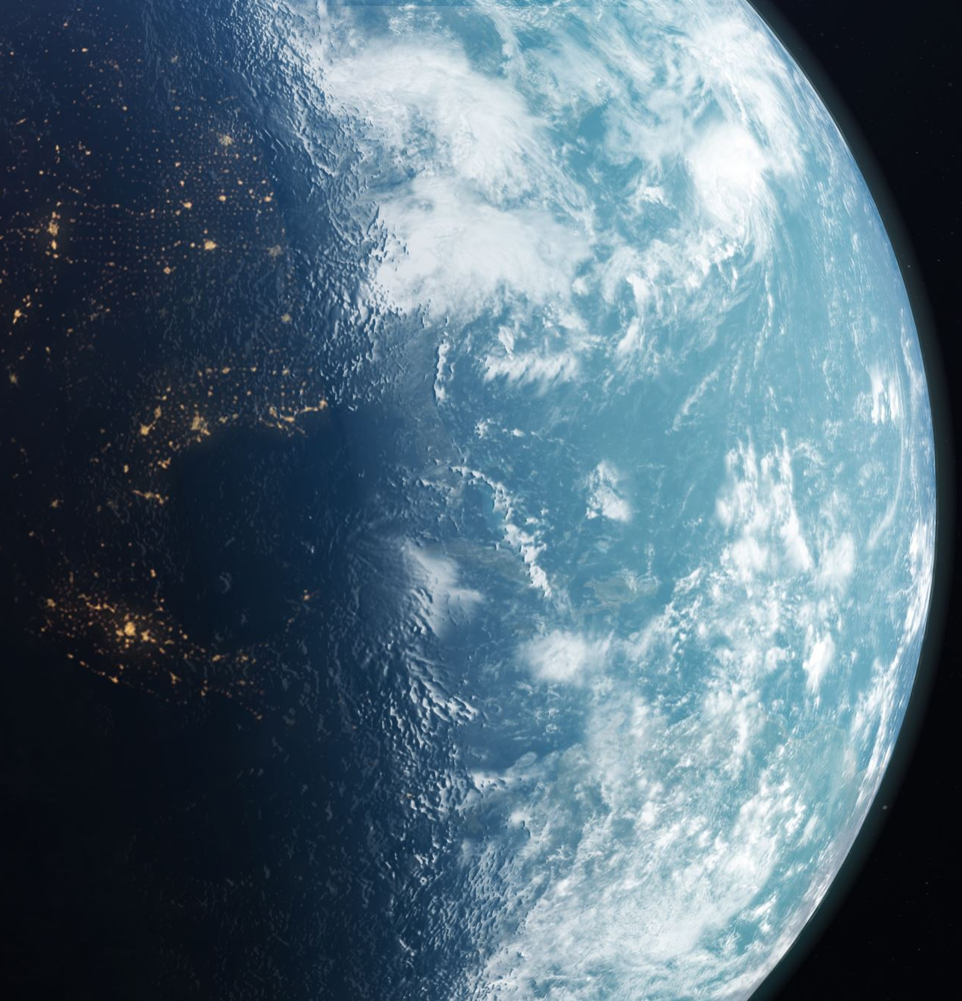
World space
In OpenGL, "world space" (or "world coordinates") is the coordinate system that represents the entire 3D scene. It is the space in which all objects are placed and oriented relative to a common origin, which typically represents a fixed point in the scene, like the center of the world.
World space provides a global coordinate system for positioning and orienting all objects in a scene.
The origin (0, 0, 0) in world space is a fixed point, and all objects are positioned relative to this point.
If we would import all our objects directly in the application, they would probably all be somewhere positioned inside each other at the world's origin of (0,0,0) which is not what we want. We want to define a position for each object to position them inside a larger world.
This is the coordinate space where you want your objects transformed to in such a way that they're all scattered around the place (preferably in a realistic fashion). The coordinates of your object are transformed from local to world space; this is accomplished with the model matrix.

Slide 53
View space
The view space is what people usually refer to as the camera of OpenGL (it is sometimes also known as camera space or eye space).
The view space is the result of transforming your world-space coordinates to coordinates that are in front of the user's view.
The view space is thus the space as seen from the camera's point of view.
This is usually accomplished with a combination of translations and rotations to translate/rotate the scene so that certain items are transformed to the front of the camera.
These combined transformations are generally stored inside a view matrix that transforms world coordinates to view space

Slide 54
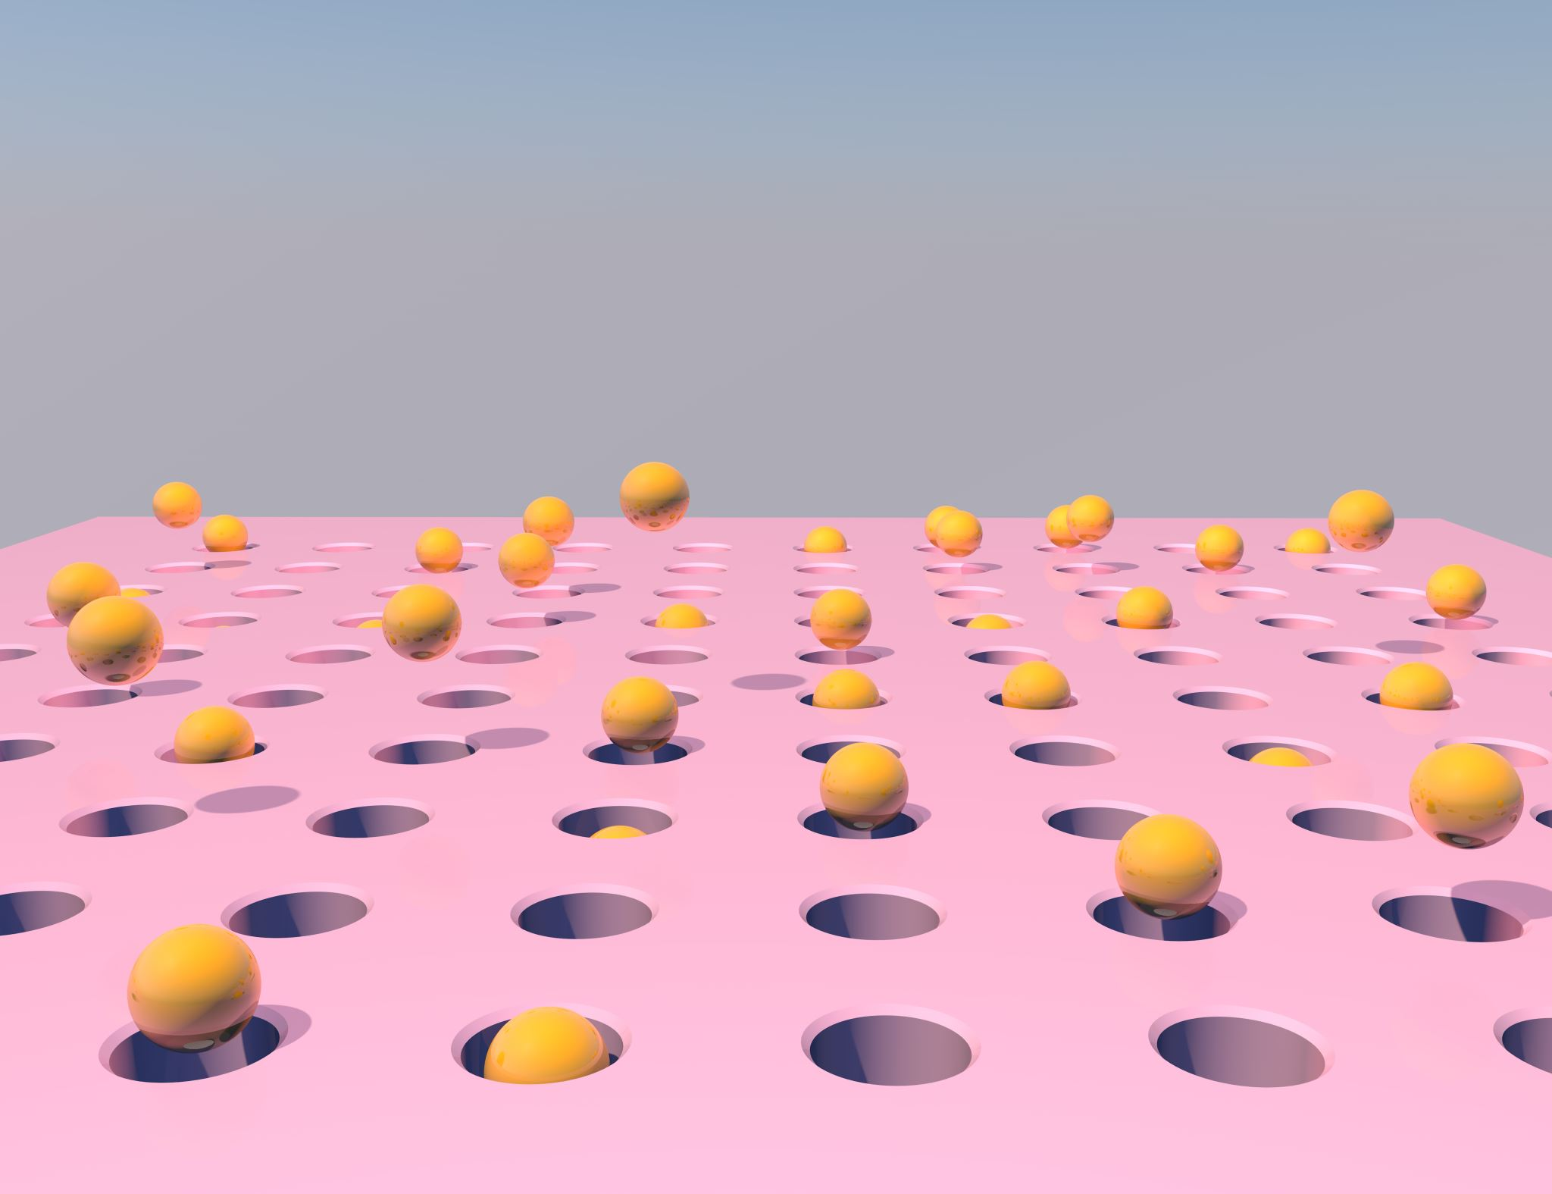
Clip space
In OpenGL, "clip space" is a coordinate system that comes into play during the graphics pipeline's transformation and rasterization stages. It's an intermediary coordinate space where vertices are positioned after the model, view, and projection transformations have been applied.
Clip space coordinates are used to determine which parts of the geometry are within the viewable area of the scene and should be rendered.
At the end of each vertex shader run, OpenGL expects the coordinates to be within a specific range and any coordinate that falls outside this range is clipped.
The remaining coordinates will end up as fragments visible on your screen. This is also where clip space gets its name from.
To transform vertex coordinates from view to clip-space we define a so-called projection matrix that specifies a range of coordinates e.g. -1000 and 1000 in each dimension.
The projection matrix then converts coordinates within this specified range to normalized device coordinates (-1.0, 1.0). All coordinates outside this range will not be mapped between -1.0 and 1.0 and therefore be clipped.
The complete transformation from model space to clip space can be represented as –
Clip Coordinates = Projection Matrix × View Matrix × Model Matrix × Local Coordinates

Slide 55
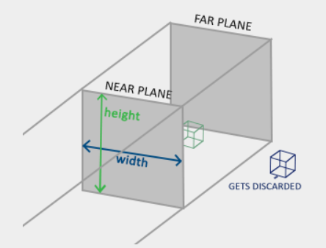
Orthogonal projection
An orthographic projection matrix defines a cube-like frustum box that defines the clipping space where each vertex outside this box is clipped.
When creating an orthographic projection matrix, we specify the width, height and length of the visible frustum.
All the coordinates inside this frustum will end up within the NDC range after transformed by its matrix and thus won't be clipped.
The frustum defines the visible coordinates and is specified by a width, a height and a near and far plane.
Any coordinate in front of the near plane is clipped and the same applies to coordinates behind the far plane.
The orthographic frustum directly maps all coordinates inside the frustum to normalized device coordinates without any special side effects.

Slide 56
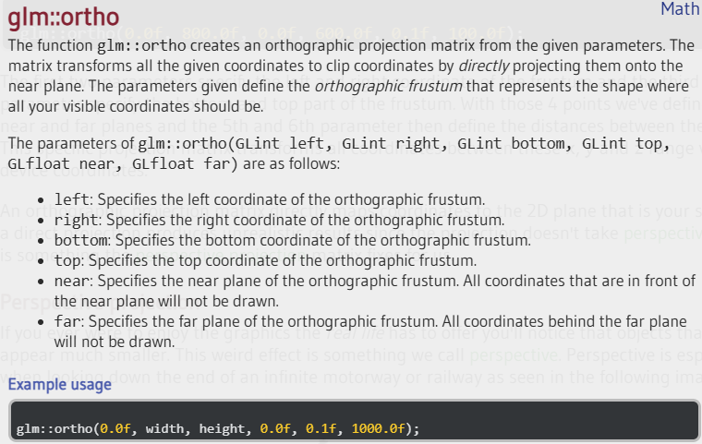
glm::ortho
Notes:
What happens when the top and bottom parameters are exchanged?
Interchanging, for example, top and bottom is equivalent to mirroring the scene along this axis.

Slide 57

Perspective projection
Perspective is especially noticeable when looking down the end of an infinite motorway or railway as seen in the image.
As you can see, due to perspective the lines seem to coincide at a far enough distance. This is exactly the effect perspective projection tries to mimic and it does so using a perspective projection matrix.
The projection matrix maps a given frustum range to clip space, but also manipulates the w value of each vertex coordinate in such a way that the further away a vertex coordinate is from the viewer, the higher this w component becomes.
Once the coordinates are transformed to clip space they are in the range -w to w (anything outside this range is clipped).
OpenGL requires that the visible coordinates fall between the range -1.0 and 1.0 as the final vertex shader output, thus once the coordinates are in clip space, perspective division is applied to the clip space coordinates.

Slide 58

glm::perspective
A perspective frustum can be visualized as a non-uniformly shaped box from where each coordinate inside this box will be mapped to a point in clip space.
Its first parameter defines the fov value, that stands for field of view and sets how large the view space is.
For a realistic view it is usually set to 45 degrees.
The second parameter sets the aspect ratio which is calculated by dividing the viewport's width by its height. The third and fourth parameter set the near and far plane of the frustum.
We usually set the near distance to 0.1 and the far distance to 100.0. All the vertices between the near and far plane and inside the frustum will be rendered.

Slide 59
Projection matrix
Mathematics derivation of projection matrices.
https://www.songho.ca/opengl/gl_projectionmatrix.html

Slide 60

Screen space
The output of the vertex shader requires the coordinates to be in clip-space which is what we just did with the transformation matrices.
OpenGL then performs perspective division on the clip-space coordinates to transform them to normalized-device coordinates.
OpenGL then uses the parameters from glViewPort to map the normalized-device coordinates to screen coordinates where each coordinate corresponds to a point on your screen (in our case a 800x600 screen). This process is called the viewport transform.

Slide 61
Viewport transform
Mathematic derivation of viewport transformation.
https://www.songho.ca/opengl/gl_viewport.html

Slide 62


Example : GLM and Coordinate transformations
Setup model, view, projection matrices separately.
Let a vertex shader handle the transformation.

Slide 63

Camera

Slide 64

View matrix - Camera
The view matrix in OpenGL is directly related to the concept of the camera.
The view matrix accomplishes the following –
Positioning the Camera - It translates the entire scene so that the camera is at the origin of the view space.
Orienting the Camera - It rotates the scene so that the camera is looking in the desired direction.
In OpenGL, there isn't a "camera" object per se. Instead, the camera's behavior is simulated using the view matrix.
This matrix represents the inverse transformation of the camera's position and orientation in the world.
Essentially, if you move the camera in the world, you apply the inverse movement to the view matrix to simulate this.

Slide 65

In Video Games, The Player Never Moves
https://www.youtube.com/watch?v=wiYTxjJjfxs

Slide 66

Defining camera position and orientation.
To define a camera, we need its position in world space, the direction it's looking at, a vector pointing to the right and a vector pointing upwards from the camera.
We are going to create a coordinate system with 3 perpendicular unit axes with the camera's position as the origin.

Slide 67

Lookat matrix
A great thing about matrices is that if you define a coordinate space using 3 perpendicular (or non-linear) axes you can create a matrix with those 3 axes plus a translation vector and you can transform any vector to that coordinate space by multiplying it with this matrix.
This is exactly what the LookAt matrix does and now that we have 3 perpendicular axes and a position vector to define the camera space, we can create our own LookAt matrix.
Where R is the right vector,
U is the up vector,
D is the direction vector and
P is the camera's position vector.

Slide 68

glm::lookAt

Slide 69
OpenGL Camera
Mathematical derivation of camera lookat matrix.
https://www.songho.ca/opengl/gl_camera.html

Slide 70


Moving camera around
Pointing forward direction
Forward / backward
Sidewalk
Notes:
Whenever we press one of the WASD keys, the camera's position is updated accordingly. If we want to move forward or backwards we add or subtract the direction vector from the position vector scaled by some speed value. If we want to move sideways we do a cross product to create a right vector and we move along the right vector accordingly.

Slide 71

Rotating camera – Pitch, Yaw, Roll
Notes:
The pitch is the angle that depicts how much we're looking up or down as seen in the first image. The second image shows the yaw value which represents the magnitude we're looking to the left or to the right. The roll represents how much we roll as mostly used in space-flight cameras. Each of the Euler angles are represented by a single value and with the combination of all 3 of them we can calculate any rotation vector in 3D.

Slide 72

Front direction defined by yaw and pitch angles.
Notes:
Mouse movement in 2d axes

Slide 73

Zooming camera
The trick is … changing the fov (field of view).

Slide 74

Adding callback functions
https://learnopengl.com/code_viewer_gh.php?code=src/1.getting_started/7.3.camera_mouse_zoom/camera_mouse_zoom.cpp

Slide 75
Homework – reading assignment (no grade)
Reviewing exercises and solutions from
https://learnopengl.com/Getting-started/Transformations
https://learnopengl.com/Getting-started/Coordinate-Systems
https://learnopengl.com/Getting-started/Camera

